Slide 1



S-100WG 1st Meeting
Status Update
JCOMM/ETMSS Weather Overlay Project
USA (NOAA NWS) and Brazil (DHN)
Tokyo-JAPAN
Mar 14th -18th , 2016
CDR. Cesar Reinert Bulhões de Morais¹
¹ Centro de Hidrografia da Marinha(CHM-Brazilian Navy Hydrographic Center)

Slide 2
Outline
Introduction/Background
Analysis/Discussion
Recommendations
Justification and Impacts
Action Required from S-100WG

Slide 3
Introduction/Background
Develop a marine weather overlay for ECDIS - JCOMM 4th session(2012)
Expected to improve marine safety services
Will provide: Analyses and forecast for maritime weather and sea state in S-100 ECDIS
NOAA/NWS/OPC is managing this project on behalf of JCOMM’s ETMSS
DHN is collaborating with NOAA on this development since 2014

Slide 4
Analysis/Discussion
NOAA/DHN wrote an article for Hydro International describing the development of IHO S-412 “Weather Overlay”
Hydro Magazine cover page article: “Designing a New Way to Deliver Marine Weather Data”

Slide 5
Analysis/Discussion
NOAA NWS has uploaded into the IHO Registry 38 objects and 23 attributes
Portrayal catalogue is still under review by ETMSS members and other interested international weather agencies

Slide 6
Recommendations
It is requested that S-100WG:
Continue providing advice and support for NOAA/DHN technical issues during S-412 development
Continue engaging private industry to develop an S-100 viewer for testing portrayal rules and conducting overlay quality control
Foster coordination with other working groups to ensure there is no duplication in the feature definitions.

Slide 7
Justification and Impacts
As additional S-100 product specifications are developed, the potential for conflicting symbology and portrayals within ECDIS will increase.
It is expected that S-100WG comments will contribute significantly to this project’s development, assuring user requirements in this interdisciplinary project are met.
This new product, together with other new products, shall impact industry and users interests transitioning to S-100 standard.

Slide 8
Action Required from S-100WG
The S-100 is invited to:
Note the progress being made in the development of this particular S-100 overlay product;
Provide recommendations that may be helpful in developing S-412; and
Support JCOMM/ETMSS S-412 activities

Slide 9
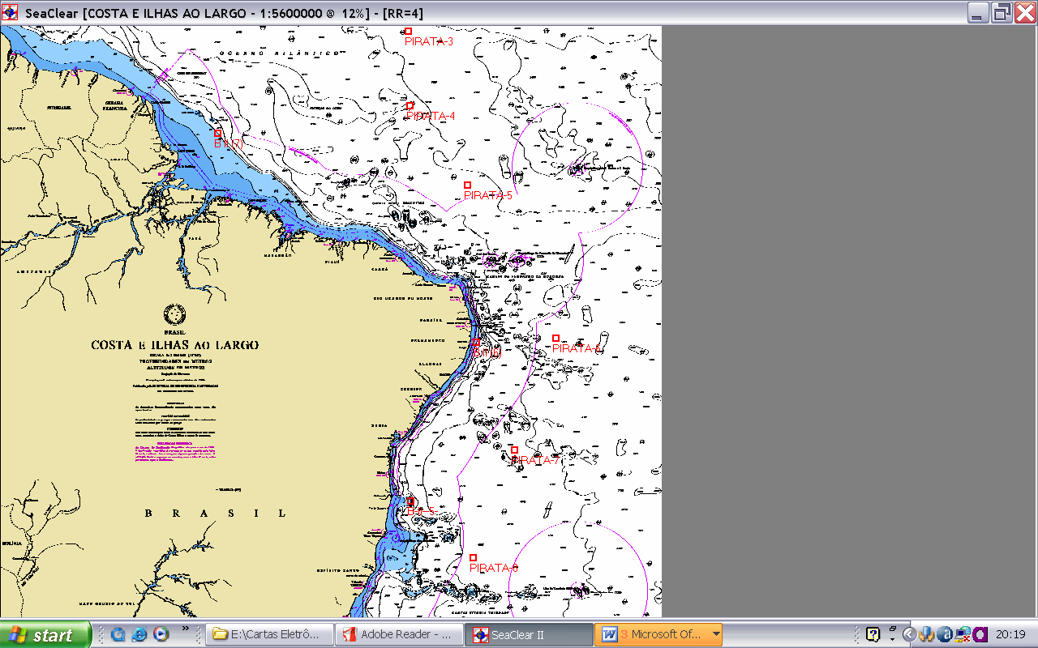
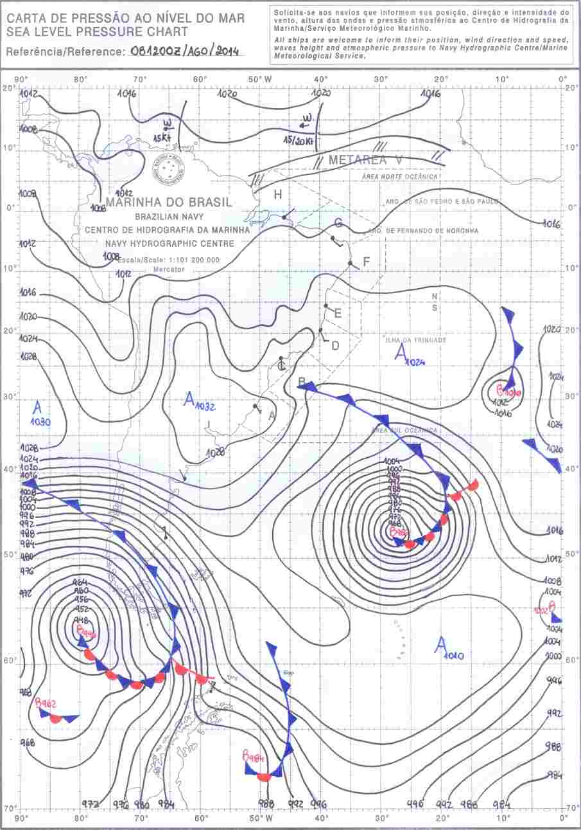
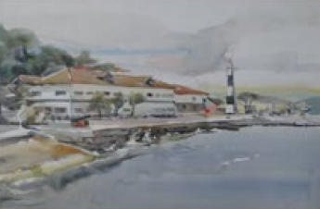
Thanks!
CESAR REINERT BULHÕES DE MORAIS
Commander
Brazilian Navy Hydrographic Center
Office Phone #: +55 21 2189-3278
E-mail: reinert@chm.mar.mil.br

